Slide 1
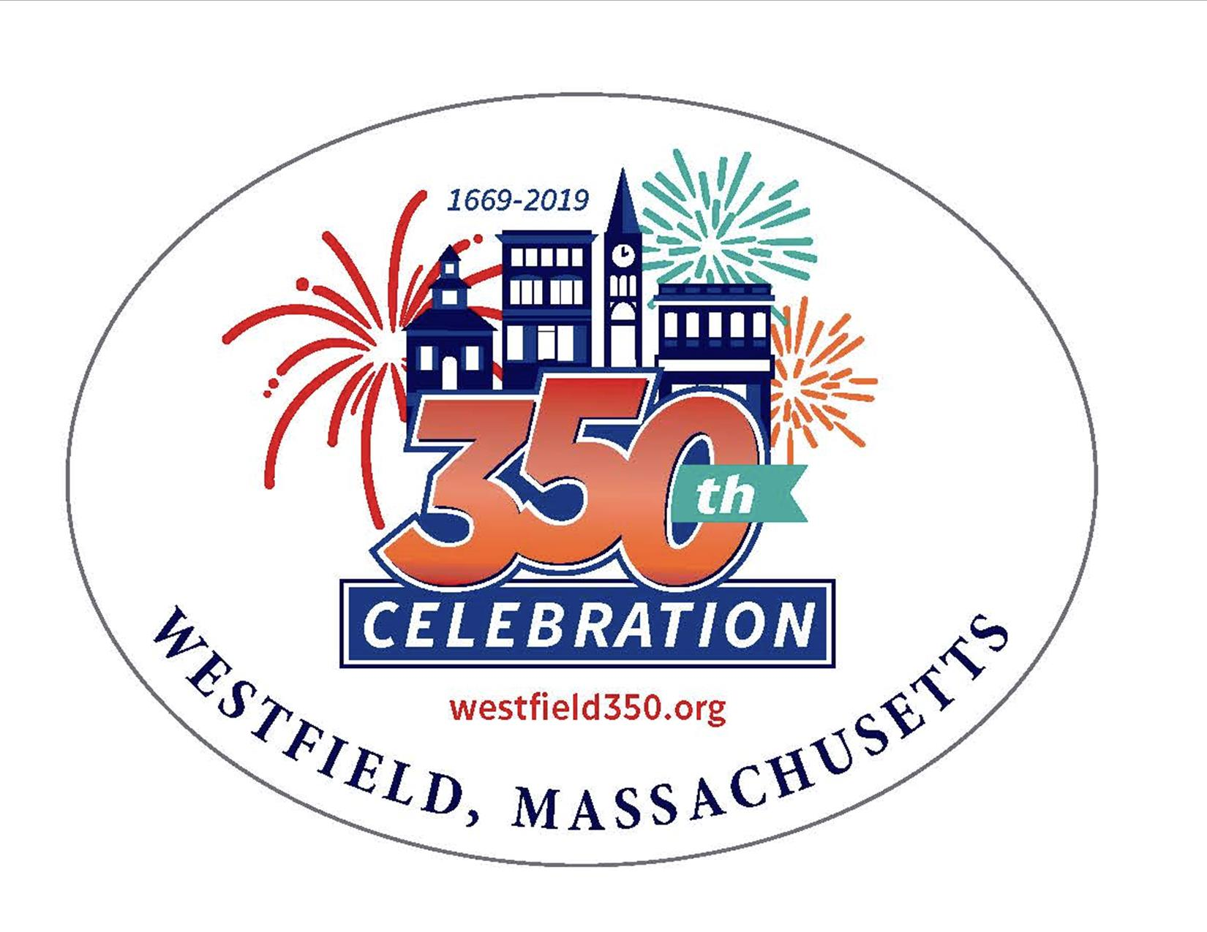
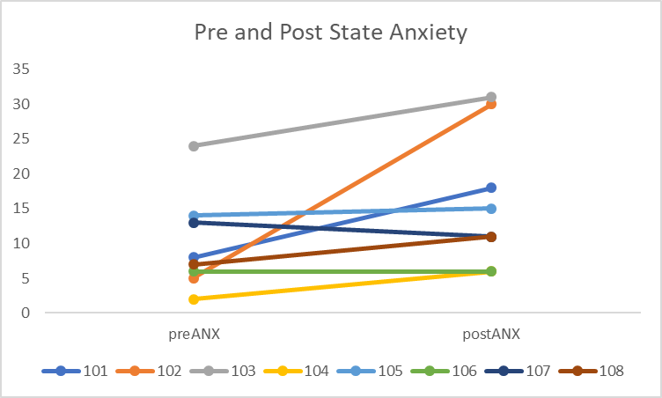
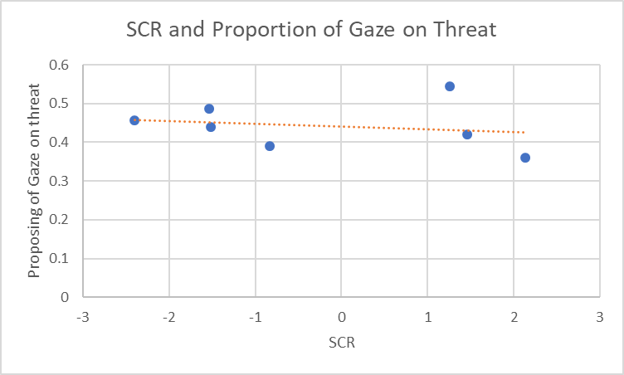
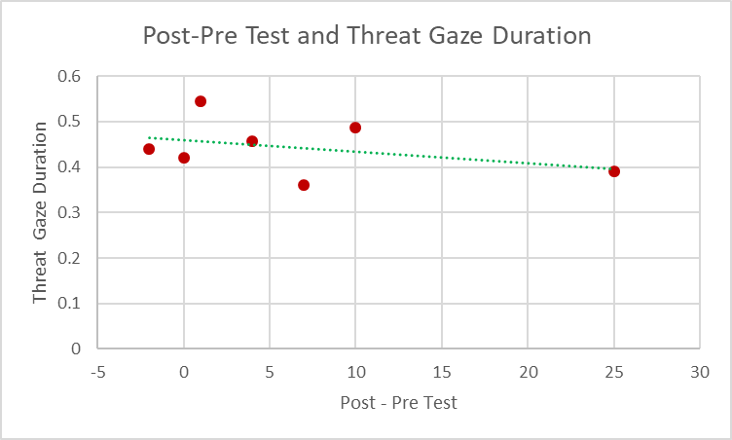
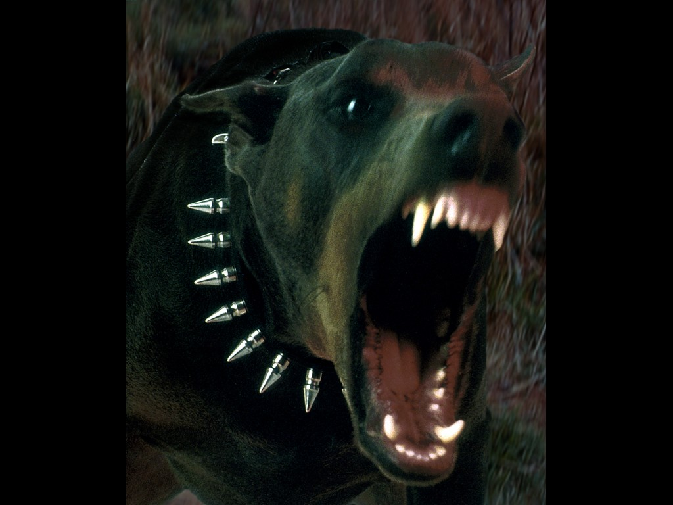
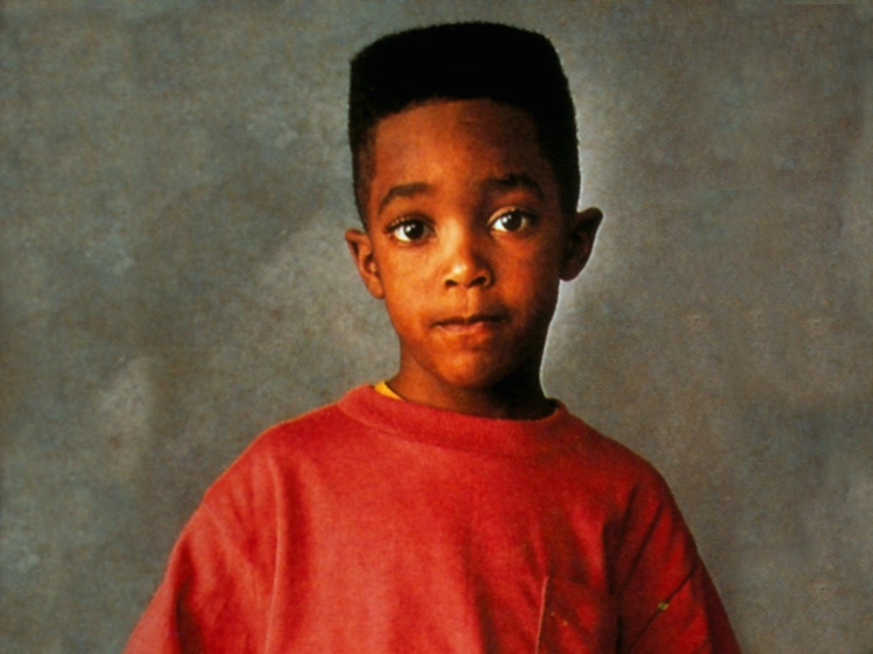
Does Anxiety Impact Attention?:
A Study Measuring Gaze Duration
Katherine Chapman
Psychology (Advisor: Dr. Alex Daniel)
Introduction
Methods
Results
Anxiety and attentional biases have been studied in the past while using imagery and eye tracking (Quigley et al. 2012), but it hasn’t been paired alongside skin conductance response. So far, no one has used only negative imagery alongside neutral imagery in this context.
I am testing how general anxiety affects the body’s response to negative and neutral imagery.
Does anxiety impact our tendency to avoid negative imagery?
Hypothesis: We expect people who tend to be anxious to avoid the negative images by looking at the neutral images more often. We also expect that the SCR will increase when participants look more at the negative image than the neutral one.
Scales
The Hamilton Anxiety Rating Scale
Will be used as a pre and post test
A Likert scale on how often a condition is felt by the participant, on a scale of 1 (not present) through 5 (very severe).
Example: Difficulty in falling asleep, broken sleep, unsatisfying sleep and fatigue on waking, dreams, nightmares, night terrors.
Additional questions involve fears, moods, and physiological symptoms.
The Free-Viewing Task
There are two images per trial, one with a neutral valance and one with a negative valance. These images were taken from the International Affective Picture System.
There are 40 trials, 30 seconds each, with a 5 second fixation cue between each trial.
Eye tracking can measure where the person is looking, for how long, their pupil diameter, and when they blink.
Measured here as proportion of time spent gazing at threatening image
Skin Conductance Response: Measures electrodermal activity through two tactile electrodes place on the middle and index finger. Higher numbers suggest more anxiety or tension.
Measured before the 5 second fixation cues on a separate computer.
r= -20837
Stimuli
r = -0.379989832
Implications
Our task induced anxiety.
The longer participants looked at the threatening image (didn’t actively avoid it), the lower their SCR was (physiological anxiety went down).
Anxiety lowered when participants didn’t avoid the threatening image

