Slide 1
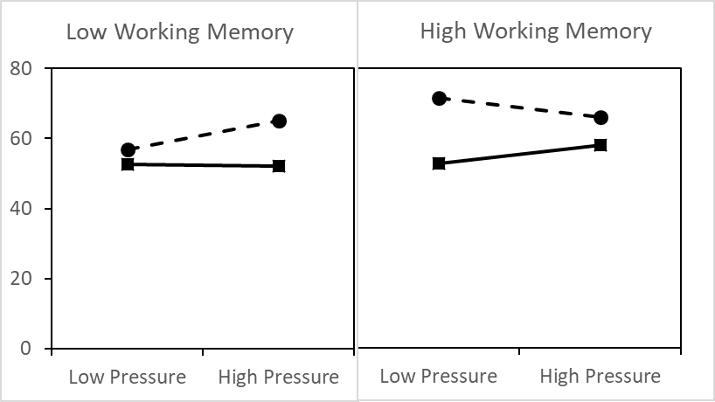
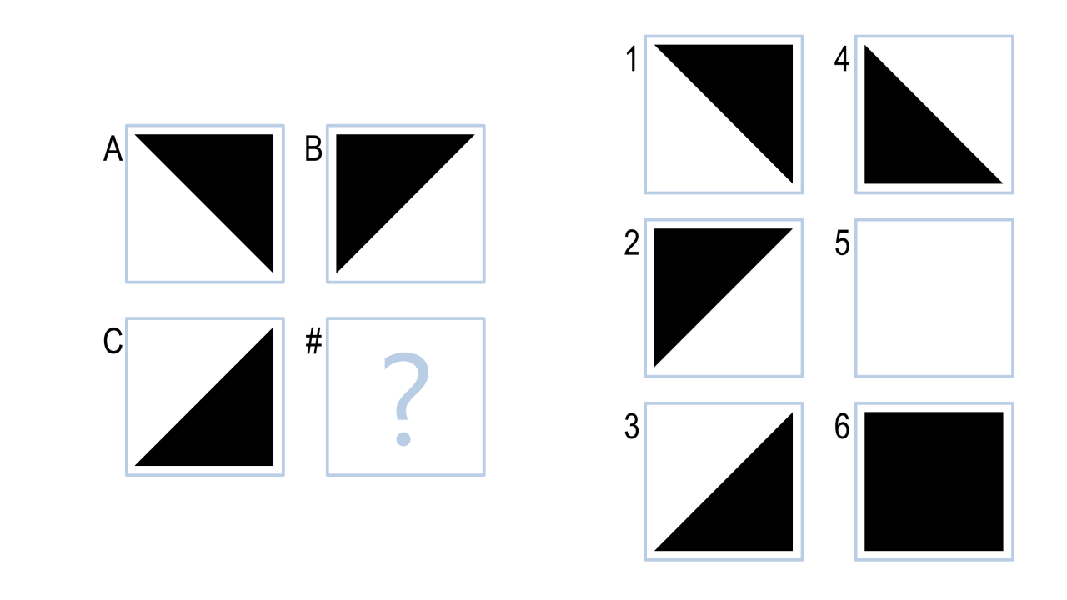
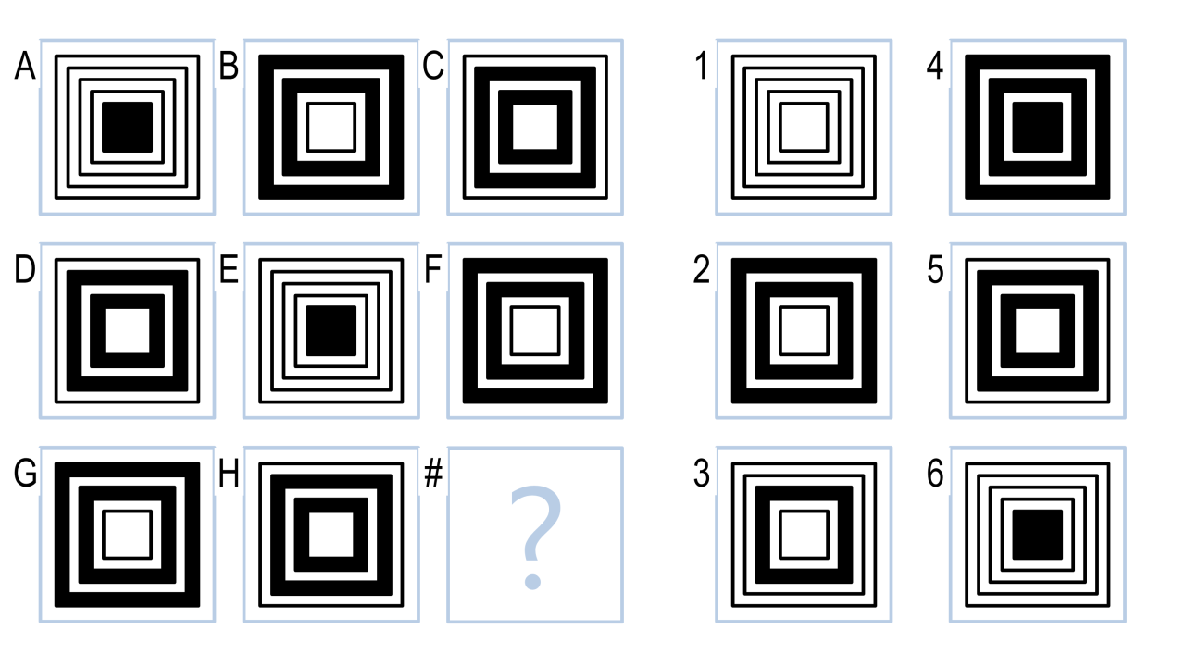
Test Taking Performance Under Pressure
Kayla Ovelheiro
Department of Psychology, Supervisor: Dr. Alex Daniel
Introduction
Methods (Cont.)
Results
Working memory: the ability to temporarily store and manipulate information in memory
Used in activities such as mental math, reading comprehension, and active listening
Beilock and Carr (2005) used Reading Span and Operations Span tests to measure working memory
They found that those who had higher working memory scores experienced a larger effect of pressure than those who scored lower on working memory tasks
This research examined how pressure affects individuals with high and low working memory on an intelligence test (Raven Progressive Matrices)
High Pressure Condition:
Participants were told they were being recorded
Told footage may be used in future psychology classes
Participants had to reduce overall time by 20%
They were told they and a partner must both reach this goal time in order to receive extra credit
OSPAN:
RSPAN:
Time…
Hypotheses
Time…
Hypothesis 1: Increased pressure will have a significant detrimental effect on test scores
Hypothesis 2: Demand of problem (high vs low) will have a significant impact on test scores
Hypothesis 2: There will be an interaction based on working memory capacity
Discussion
Hypothesis 1:
Low working memory participants performed better with an increase in pressure
High working memory participants performed worse with an increase in pressure
Hypothesis 2:
Demand of the problem will have an impact on test scores. High demand problems will be more difficult to perform
Hypothesis 3:
When you have “high” working memory, pressure causes your performance among low demand tasks to be worse
When you have “low” working memory, pressure improves performance among low demand tasks
Future Directions/Implications
Continue data collection
Pressure affects performance:
How can we apply these results to academics?
Timed exams such as SAT/ACT
Should we remove time limits and model these exams after MCAS?
Methods
Replication of Beilock and Carr (2005)
Participants (N=10)
Perform Reading Span & Operations Span tests
Categorize “high” & “low” working memory
Perform intelligence task
24 problem Low Pressure Test
24 problem High Pressure Test
Each had 12 difficult and 12 easier problems presented randomly
OSPAN:
Participants were presented with a series of arithmetic equations and asked to verify if each is correct.
They were expected to remember a letter in between each equation
Must remember the letters in order at the end of the sequence
RSPAN:
Participants were presented with sentences and asked to verify if they make sense
They were asked to remember the last word of each sentence and type them at the end of the sequence
Low demand
High demand
References
Beilock, S. L., & Carr, T. H. (2005). When high powered people fail: Working memory and “choking under pressure” in math. Psychological science, 16(2), 101-105.

