Slide 1
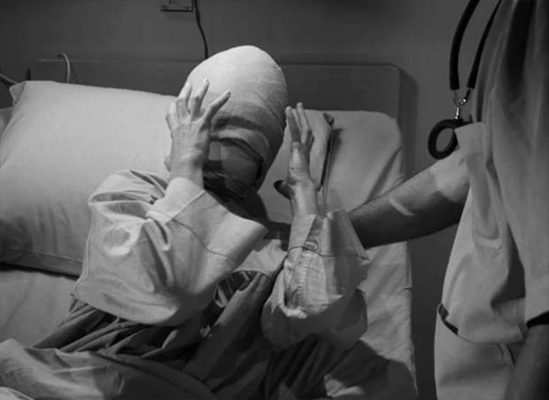
Spoilers Don’t Spoil When Participants Choose What to Watch
Olivia B. Gwynn
Department of Psychology, Westfield State University
Introduction
Methods (cont.)
Results (cont.)
Studies have shown that giving participants spoilers about a particular media will affect their rating of enjoyment.
Leavitt and Christenfeld (2010) found that spoilers actually increase enjoyment
Daniel and Katz (2018) no effect on short stories with spoilers, but TV spoilers had a detrimental effect
Johnson and Rosenbaum (2018) found that Need for Cognition predicted whether spoilers effected enjoyment.
Previous research simply assigned stories/television regardless of participant preference
The Twilight Zone
Community
Black Mirror
This is Us
Hypotheses
Hypothesis 1: Episodes with a spoiler will be rated lower than episodes without a spoiler
Hypothesis 2: Participants with higher ratings on the NFC scale will be affected differently by spoilers
Possible interaction between NFC score and Spoilers
Methods
Discussion
Administered an online survey
Participants (N = 131) were assigned two groups:
Spoiled summary and Unspoiled summary
Participants chose one of four television episode genres:
“A classic featuring a woman who is recovering from surgery”
“A violent, intense dystopian look at the future”
“A modern comedy on a college campus”
“A modern drama featuring four characters’ stories”
Asked to rate how much they expected to enjoy the episode based on a brief summary (1 – 9)
If in the Spoiled condition, the summary contained a spoiler about the episode’s ending
After watching the episode, participants had to rate how much they enjoyed the episode (1 – 9)
Need for Cognition Scale
“I would prefer complex to simple problems.”
“Thinking is not my idea of fun.”
Need for Affect Scale
“Emotions help people to get along in life.”
“I think it is important to be in touch with my feelings.”
Results
Spoilers might spoil stories but…
Hypothesis 1:
No significant difference between spoiler condition!
Maybe spoilers don’t matter (much)?
Lack of significant effect may come from individual differences (figure 2).
Hypothesis 2:
Participants with higher rating on the NFC scale were affected more by spoiled/unspoiled episodes than the participants who scored lower on the NFC scale.
Participants with high NFC scale score enjoyed the episode less when it was spoiled.
This data accurately reflects the previous data (especially Johnson and Rosenbaum)
Future Directions
Continue data collection
A larger sample is needed due to small effect sizes
Have participants select a summary, but they are shown a different episode (manipulation of preference)

